Slide 1
KultureHire Data Analysis Internship
Understanding
Career Aspirations of
Gen Z
Kunal Warghade

Slide 2
Introduction
Overview of Gen Z and why their career aspirations matter.
Purpose of the study: What are their career preferences, expectations, and challenges?
Importance of data-driven insights in understanding career trends

Slide 3
Objectives
What industries are most attractive to Gen Z?
Purpose What factors influence their career choices?
What is the desired work environment for Gen-Z? (e.g., remote, hybrid, in-office)What challenges do they face in career development?
How do financial goals, such as salary and benefits, impact career aspirations among Gen-Z?
What role do personal values and social impact play in career choices for Gen-Z?

Slide 4
Methodology Used in Project
1. Problem Statement
Used 5W1 framework to Understand Business Problems.
Prepare Questions in MS Word with the help of Article related to Gen Z Career Aspiration.
2. Data Collection
Used Questionnaire method with the help of AI tool Chat GPT by creating Google Form and response from Gen Z’s.
With the help of social platforms gather the response from Gen Z Candidates .
3. Data Cleaning
Load Data into Ms. Excel.
Used Power Query Editor.
Remove duplicate rows.
Fill null values with Specific values as per instructions.
Split data row wise.
Reduce text Redundancy.
Rename column headers.

Slide 5
4. Exploratory Data Analysis
Used Pivot Tables in Ms Excel.
Create Pivot Tables as per Business Requirements.
Grouped Data with the count of Respondents.
Summarized the findings as per Business Questions.
5. Analyzing in SQL
Conducted Data Analysis using MySQL, solve complex questions using CTE (Common Table Expressions).
Used Group by, Order by and Aggregation function like count.
6. Excel Dashboard
Generate Dashboard on Career interest and Aspirations on Gen Z.
Used graphs like bar charts, column charts and Pie charts.
Generate KPI’s and add slicer Gender wise.

Slide 6
7. PowerBI Dashboards
Created 2 Power BI dashboard summarizing Gen-Z's mission aspirations, and manager aspirations.
Used graphs like bar charts, column charts and Pie charts and Generate KPI’s.
8. Presentation
Worked on an employer-focused project, creating recommendations and emphasizing the importance of storytelling in data.

Slide 7
1. Problem Statement
Used 5W1H Frame Work
What
Why
When
Where
Who
How

Slide 8
What
What are advantages GenZ’s have which make them better workforce than previous generations ?
GenZ’s are born in age when knowledge work is dominant than industrial work.
Their knowledge and skill set has fully developed at the time of course studies.
Personal Thoughts
They have technological advantages like Wi-Fi, high speed internet, availability of research and documents on internet
2. What are the career experiences of GenZs?
Negotiate for compensation for direct report.
Deeply involved or entangled in disagreements, arguments, or disputes within the workplace.
Terminating their employment with the organization, typically due to reasons such as poor performance, misconduct, redundancy, or breaches of company policies.
Choose to work at other organization for financial growth over promotion in current organization.
Need to manage their low performance.

Slide 9
Why understanding GenZ’s is important ?
GenZ’s will surpass previous generation to become most populous generation.
GenZ’s are about to enter in workforce that you produce provide and create, which will effect businesses.
Why
Why there is declined in Planned Career in GenZ’s ?
Only 37% of GenZ’s knows what they want from applied position.
GenZ’s grows in technological advanced surrounding which makes life easier and faster.
They seek rapid growth and reward for their efforts.
When
When did career expectations of GenZ’s changes?
From 2017 from age 21 to 24.
After technological development.

Slide 10
Where
Where GenZ’s found their new employment ?
GenZ’s are eager for rapid growth and reward, so they mostly look for organization where they will get paid more than previous one.
How
How we can influence GenZ’s for their Career ?
GenZ’s spend most of the time with their parents, professors in educational institute, by teaching them about career development.
GenZ’s focused on skill development, in this training also we can influence them about career planning.
Who
Who are getting affected by GenZ’s career preference ?
Most of the industries, organizations and employers getting affected by GenZ’s career preference.

Slide 11
Conclusion
We can bridge the gap between GenZ’s career preference and employer expectations by analysis GenZ’s needs. As GenZ will be next workforce, it is very crucial for every organization to understand GenZ’s preferences. By understanding skill preferences and educating them about long term career planning organizations can make best use of GenZ workforce.

Slide 12
2. Data Collection
Used Survey method for Data Collection
Create Google form to gather response
Post survey on social media platform like LinkedIn
Stored Data in Ms Excel.

Slide 13
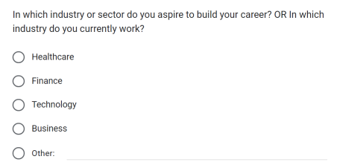
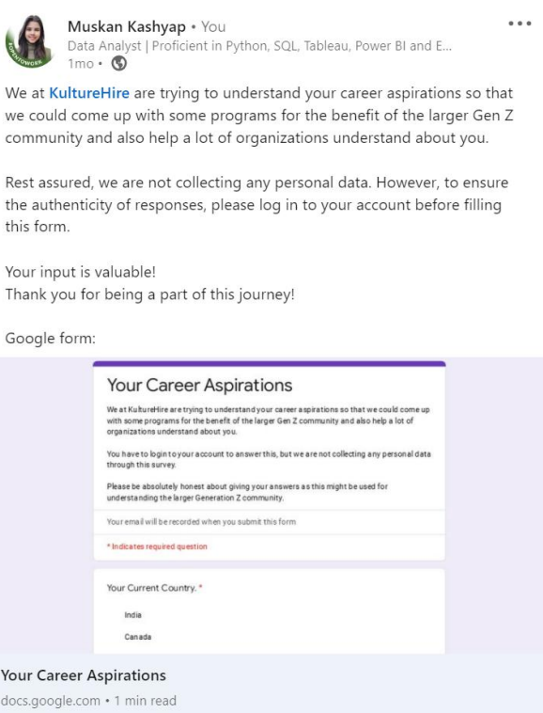
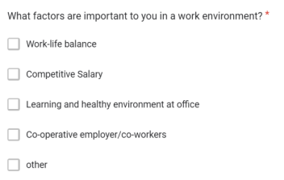
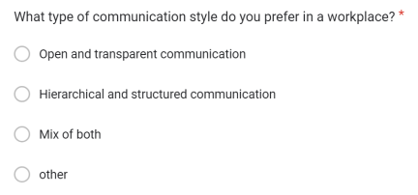

Slide 14
3. Data Cleaning
Load Data into Ms. Excel.
Used Power Query Editor.
Remove duplicate rows.
Fill null values with Specific values as per instructions.
Split data row wise.
Reduce text Redundancy.
Rename column headers.

Slide 15
4. Exploratory Data Analysis
Used Pivot Tables in Ms. Excel.
Grouped Data with th count of respondents.
Summarized the findings as per Business Questions.
Visualize Data with charts.

Slide 16
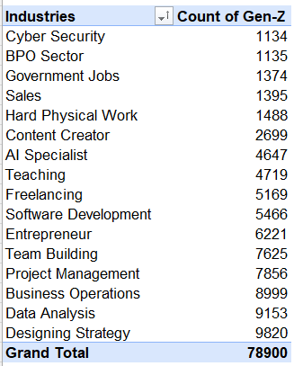
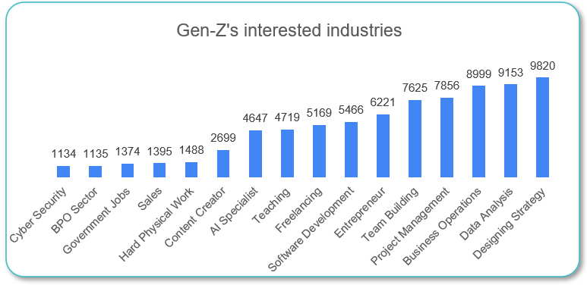
1. What industries are Gen-Z most interested in pursuing careers in?
Summery
Top Fields: Design & Creative Strategy (9820) leads, followed by Data Analysis (9153) and Business Operations (8999).
Mid-Tier Fields: Project Management (7856), Team Building (7625), and Entrepreneurship (6221) show moderate engagement.
Lower Engagement Fields: Cyber Security (1134), BPO Sector (1135), and Government Jobs (1374) have the lowest values.

Slide 17
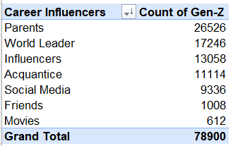
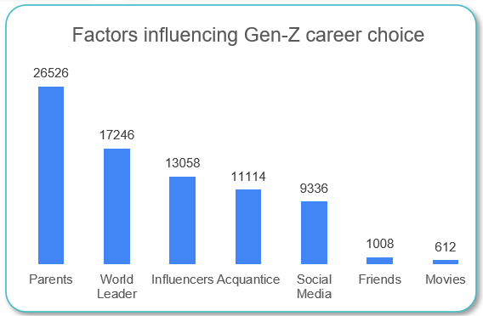
2. What are the top factors influencing Gen-Z’s career choices?
Summery
Top Career Influencer: Parents (26,526)
Strong Influence: World Leaders (17,246), Influencers (13,058)
Moderate Influence: Acquaintances (11,114), Social Media (9,336).
Least Influence: Friends (1,008), Movies (612)

Slide 18
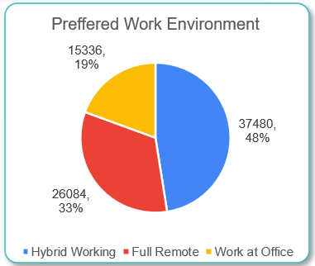
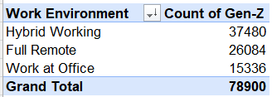
3. What is the desired work environment for Gen-Z? (e.g., remote, hybrid, in-office)
Summery
Gen-Z prefers Hybrid Working (37,480) the most, followed by Full Remote (26,084), while Work at Office (15,336) is the least favored.

Slide 19
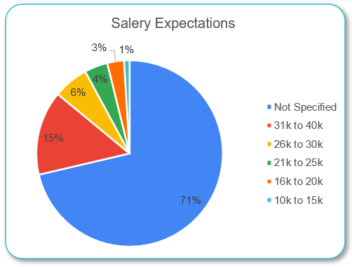
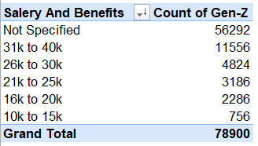
4. How do financial goals, such as salary and benefits, impact career aspirations among Gen-Z?
Summery
Majority Didn’t Specify: 56,292 respondents didn’t mention salary preferences.
Most Preferred Salary Range: 31K-40K (11,556).
Moderate Preference: 26K-30K (4,824), 21K-25K (3,186).
Less Preferred: 16K-20K (2,286).
Least Preferred: 10K-15K (756).

Slide 20
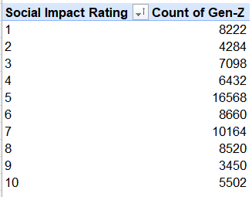
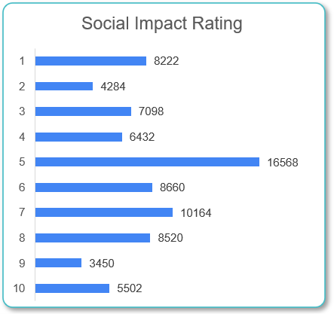
5. What role do personal values and social impact play in career choices for Gen-Z?
Summery
Higher ratings (7-10) are more common, with 16568 candidates giving a 5-star rating.
Lowest ratings (1-3) exist but are less frequent, showing mixed but generally positive views on impact.

Slide 21
5. Analyzing in SQL
Conducted Data Analysis using MySQL, solve complex questions using CTE (Common Table Expressions).
Used Group by, Order by and Aggregation function like count.

Slide 22
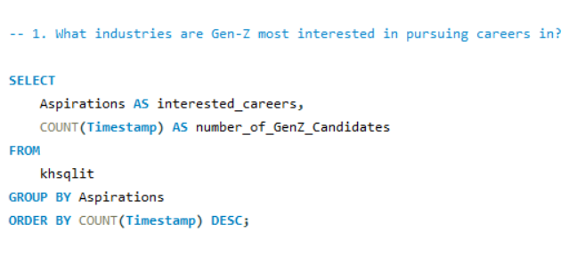

Slide 23
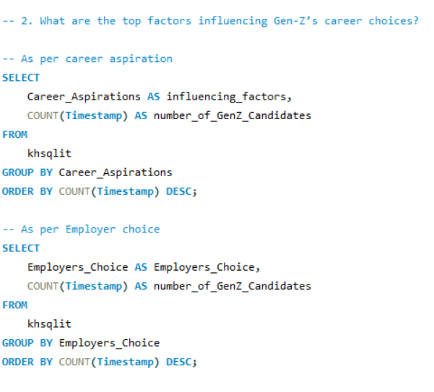

Slide 24
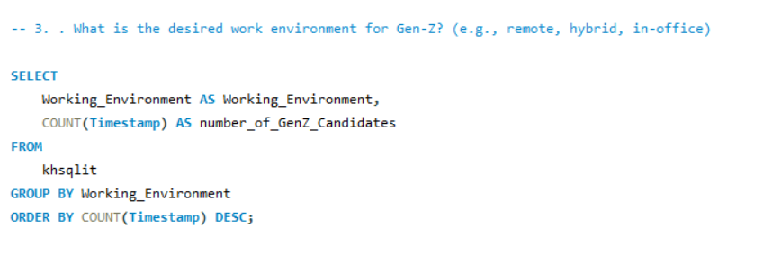

Slide 25
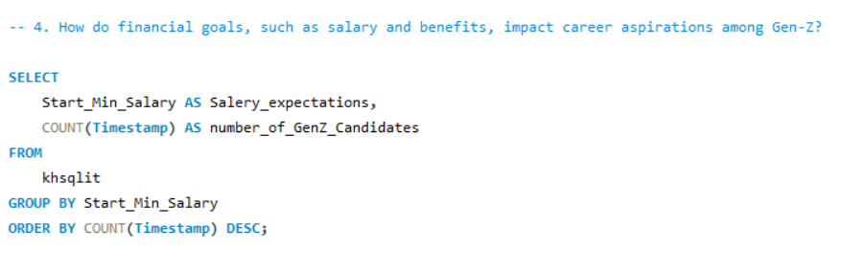

Slide 26
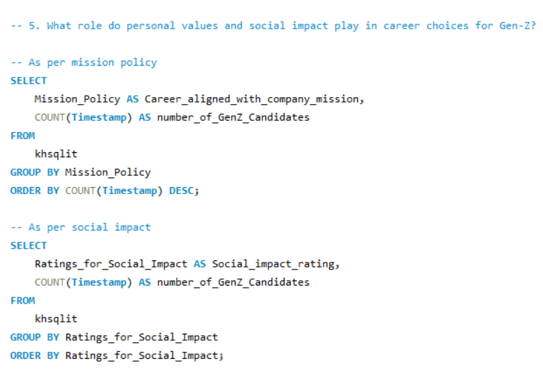

Slide 27
Empowering Gen-Z Career Aspiration
6.Excel Dashboard

Slide 28
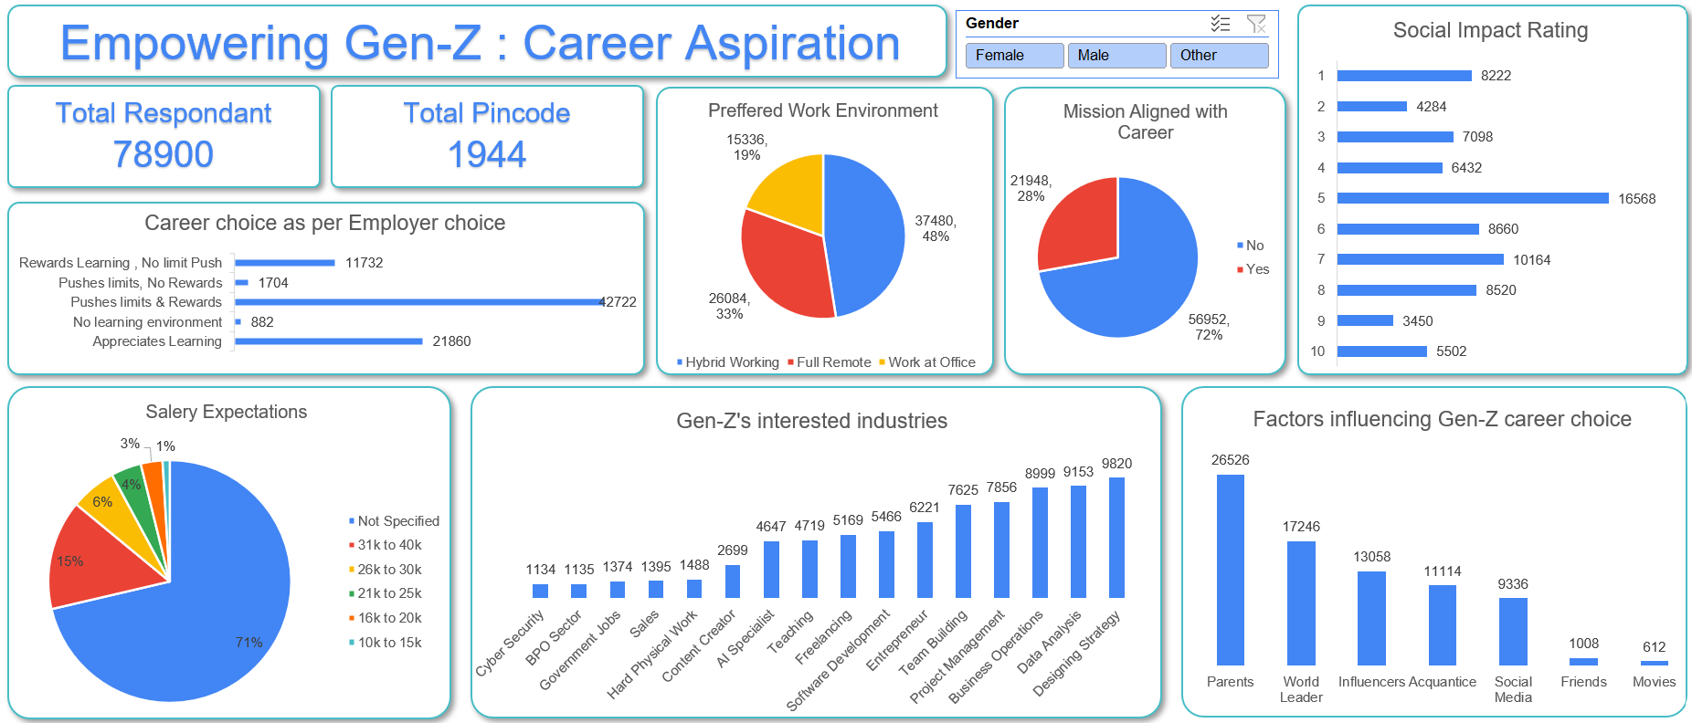

Slide 29
Manager Aspiration Dashboard
7. PowerBi Dashboards
Mission Aspiration Dashboard

Slide 30
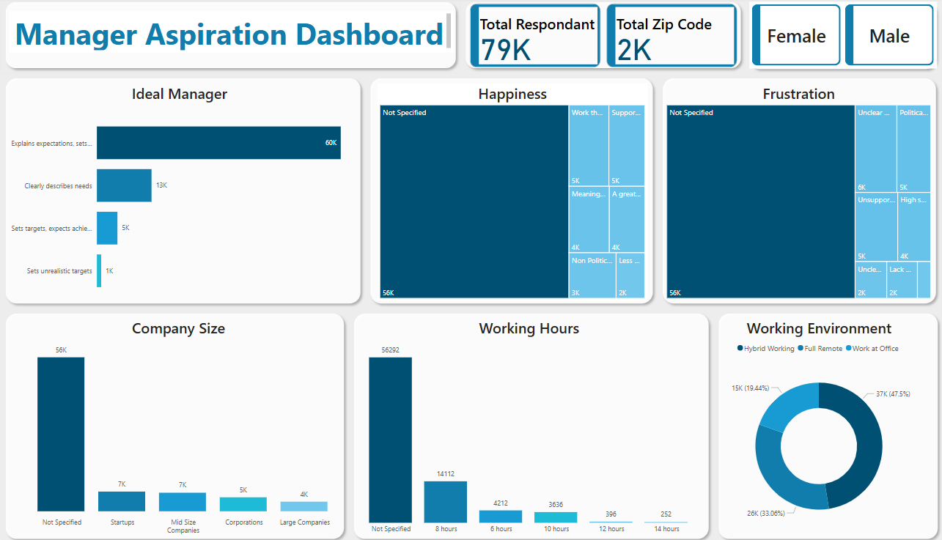

Slide 31
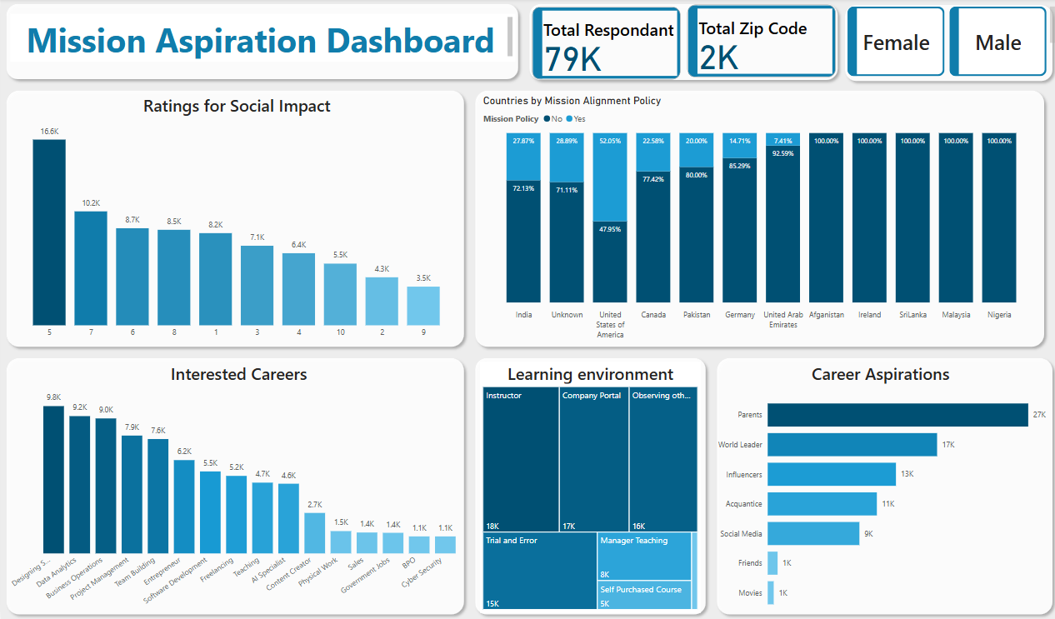

Slide 32
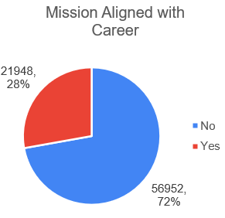
Insight
Problem
Career Goals/Mission not Aligned with Job
Recommendations
Identify concerns.
Improve communication.
Offer incentives/training.
Re-evaluate policies with Gen-Z input.

Slide 33
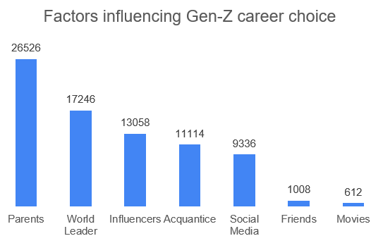
Insight
Problem
Makes career decisions by get influenced by surroundings.
Recommendations
Engage parents in career guidance programs
Promote inspiring leadership stories
Collaborate with credible industry experts & Provide reliable career content online

Slide 34
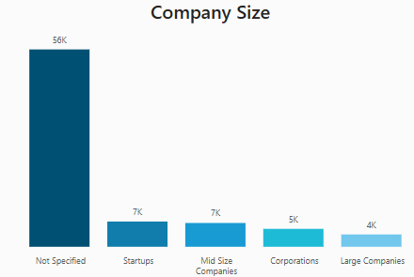
Insight
Problem
Not aware about where to start career.
Recommendations
Increase career awareness programs
Highlight startup growth opportunities
Promote stability and career paths
Showcase impact-driven roles in big firms

Slide 35
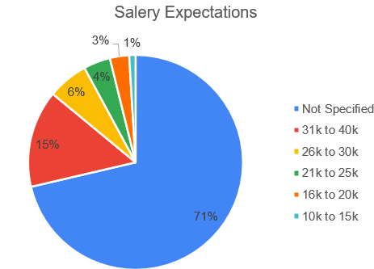
Insight
Problem
Unclear career direction based on salary expectations
Recommendations
Provide salary benchmarks for different career paths
Offer guidance on realistic salary expectations
Educate on skill-based earning potential

Slide 36
Thank You

